Slide 1



Session IX - Master Mediator Commentary on Mediation in Action
Moderator: Felicity Steadman

Slide 2
Master Mediator Commentary on Mediation in Action
⏱️ 60 min – Live role-played mediation 💬 15 min – Audience debrief & Q&A 🎯 Goal – Show how a mediator: Helps parties rethink rigid positions Identifies underlying interests Helps find mutual solutions to reconcile differences

Slide 3


E-MOTIX GmbH | EMOTEC S.A
🛴 E-scooters & urban mobility 🌍 Active in several EU countries 🏭 Manufacturing outsourced to Vietnam 🌱 Youthful, sustainable, eco-friendly brand | ⚙️ Drive systems & control units 🚗 Clients: car & truck manufacturers 💻 Embedded software solutions 🔗 B2B model (OEM clients only)
Notes:
In just a few minutes, you will see a mediation role play based on a dispute between two companies: one German and one French. The German company, E-MOTIX, specialises in scooters and urban mobility solutions, while the French company, EMOTEC, develops drive systems and control units for manufacturers.

Slide 4
E-MOTIX | EMOTEC
EUTM application filed in 2024 Class 9: mobile apps, battery chargers, GPS modules, on-board software Class 12: electric scooters, personal mobility devices | Earlier right EUTM registered since 2021 Class 7: electric motors and mechanical components for land vehicles Class 9: embedded control software, apparatus for performing automotive diagnostics Class 12: electronic drive systems, vehicle control units
Notes:
E-MOTIX applied for an EU trade mark for products in classes 9 and 12. EMOTEC is the holder of an earlier trade mark which is registered for products in the same classes and additionally enjoys protection specific products in class 7.
You can find more detailed information about the case via the QR code linking to the conference materials, and in the video we’re about to watch.

Slide 5
How does mediation start at the EUIPO
Notes:
Now we will see a 2-minute-video showing how the case explained arrived to the EUIPO mediation centre and how does it start. Please play the video

Slide 6





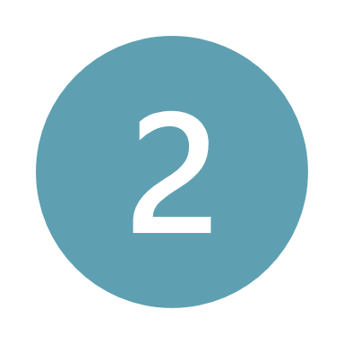
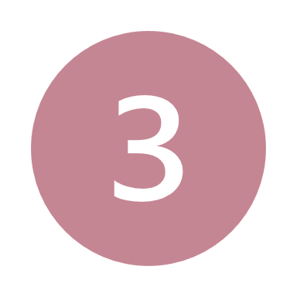
  Process
Suspension of proceedings
Appointment of mediator
Mediation day
Initiation
Conclusion
4
5
Notes:
In the video we’ve seen how the case arrived to the mediation centre through a unilateral request from E-MOTIX , but this is not the only way.
Initiation. A mediation can be started in three ways:
Unilateral request, as we have just seen when one party involved in proceedings before the EUIPO submits the request form.
Joint request: when the request from both parties to the dispute is received, the Mediation Centre will proceed to organise the process.
Proposal: The rapporteur or case examiner responsible for the file at the relevant proceedings pending before the EUIPO may suggest that the parties consider mediation.
If both parties agree to proceed with mediation, the EUIPO will suspend the proceedings already pending before the relevant instances until the mediation is concluded.
3. Then, the Mediation Centre invites the parties to appoint a mediator by suggesting possible candidate/s.
4. The Mediation phase consist of the actual mediation session or sessions. In the next slide I will summarise the steps that participants should expect during these sessions.
5. The Conclusion of the process will be confirmed formally by the mediator who will also inform the Mediation Centre about the outcome. The Centre, in turn, informs the relevant instance to lift the suspension of the main proceedings.

Slide 7
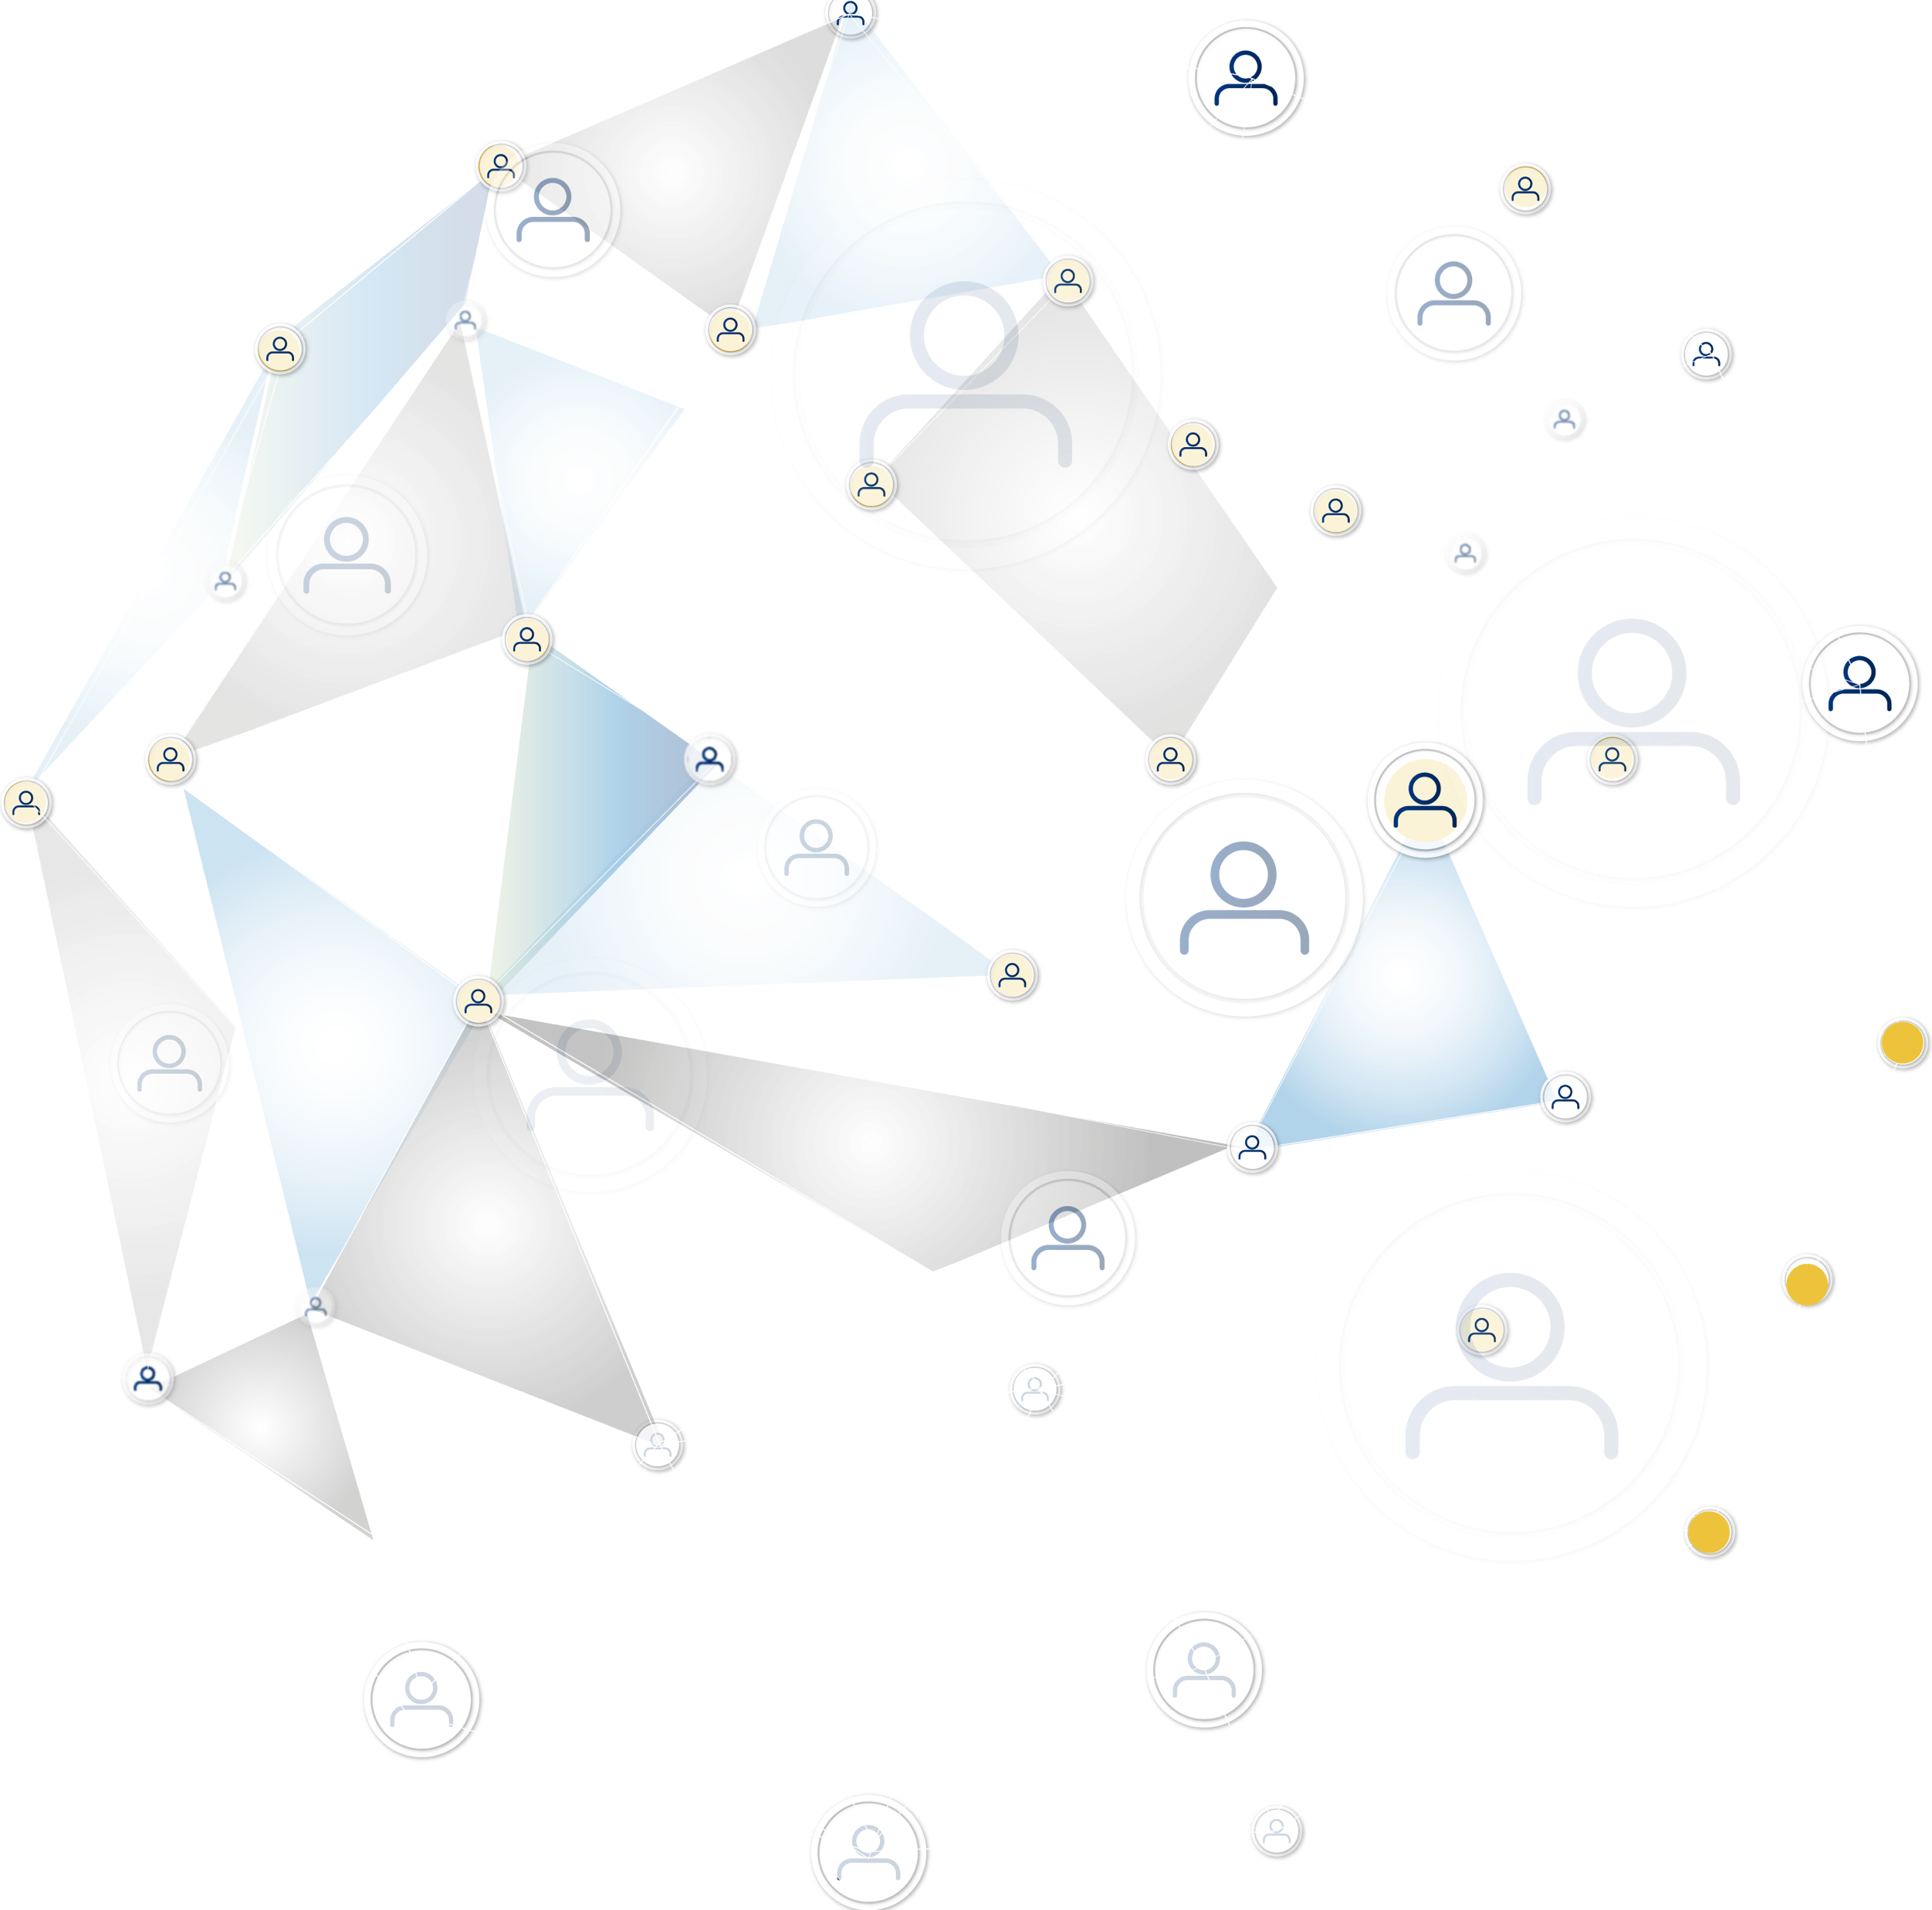
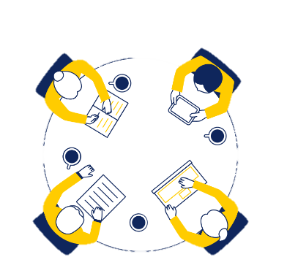
  Mediation day
OPENING
EXPLORATION & BARGAINING
CONCLUSION
GROUND RULES
OPENING STATEMENTS
AGENDA
JOINT AND SEPARATE MEETINGS
INTERESTS
IDEAS FOR SETTLEMENT
WITH SETTLEMENT
NO SETTLEMENTT
Notes:
Typically, a mediation begins with an opening session. During this session, the mediator sets the ground rules, and each party presents their opening statements, outlining their positions and interests. The parties then agree on an agenda for the day, identifying the key points they wish to discuss.
The mediator may also meet with each party separately in private sessions to better understand their interests. During these private discussions, they explore ideas and potential solutions that can be brought back to the other party.
The goal of mediation is to reach a settlement. If a settlement is not achieved, the case returns to the regular process, where the Office will make a formal decision.
At this stage we will start with the role-play where you will have the chance to go through all the mediation phases, starting with the opening and finishing with the conclusion.

Slide 8

Opening Phase
ACTION
Notes:
The first phase, as mentioned before, is the Opening phase. Please pay attention.
ACTION!

Slide 9
Topics for discussion
- Business use of the mark
OPENING
STATEMENTS
- Brand concerns
- Business development and future ventures

Slide 10
KEY
PRINCIPLES
OPENING
STATEMENTS
Confidentiality and without prejudice
No agreement until written down and signed
Party autonomy
Authority
Respectful communication
Mediator’s role
Initial Positions:
Brand protection
Market distinction
Notes:
What we’ve just seen is the opening phase of the mediation process — a critical first step that sets the tone for what’s to come.
In this session, the mediator emphasised key principles: confidentiality and without prejudice, no agreement until written down and signed,, party autonomy, authority and respectful communication. This last point became especially important when an interruption occurred during one party’s opening statement. The mediator stepped in promptly — calmly acknowledging the emotion behind the interruption, reminding the parties of the agreed rules, and ensuring the speaker could finish without further disruption. This early intervention is essential to protect the sense of fairness and to keep both parties engaged in the process.
We also heard opening statements from both sides — clear expressions of their initial positions:
EMOTEC focused on brand protection, emphasising the legal overlap in trademark classes and the risk of confusion in a rapidly evolving tech space.
E-MOTIX stressed their market distinction, highlighting differences in customer base and branding, while underlining the urgency to move forward with product launches and avoid unnecessary legal delays.
These are classic examples of positions — what each party says they want. But mediation goes deeper.
In the next phase — the exploration phase — the mediator will meet with each party privately. The aim will be to unpack these positions and identify the underlying interests: the business needs, strategic concerns, and personal stakes that lie beneath the legal arguments.
This is where the heart of mediation lies — not just clarifying legal claims, but understanding what truly matters to each side, and opening the door to options neither party may have considered.
Let’s now move into that exploration stage.

Slide 11
Exploration
Phase
ACTION

Slide 12
Positions
E-MOTIX: There is no overlap. The marks are different. We should be allowed to use our name.
EMOTEC: This name is too close. It falls within the same classes. We oppose the registration.
Techniques
Active listening
Open-ended questions
Reframing
Interests
E-MOTIX: Urgency of a delayed launch, storage costs and the risk to investor confidence.
EMOTEC: Desire to protect their reputation in a conservative B2B market, avoid setting a dangerous precedent, and ensure their brand remains distinct.
Notes:
In the private session with EMOTEC, we saw a different set of interests emerge: a desire for legal certainty, brand clarity, and protection of their long-term strategic positioning. Their tone was cautious, but the mediator’s open questions helped them articulate not just what they feared, but what would give them confidence.
We’ve now seen the exploration phase in action — beginning with emotional positions and moving toward the identification of interests. Let’s take a moment to reflect on how the parties’ positions evolved through the mediation.
In the opening session:
E-MOTIX stated firmly: “There is no overlap. The marks are different. We should be allowed to use our name.”
EMOTEC countered: “This name is too close. It falls within the same classes. We oppose the registration.”
These are classic examples of positions — the outward demands or fixed statements people initially present.
But what happened in exploration?
The mediator, through private and confidential dialogue, helped uncover the deeper interests behind these positions:
For E-MOTIX: The urgency of a delayed launch, storage costs, the risk to investor confidence, and a fear that their brand — built to speak to urban consumers — would be unfairly stifled.
For EMOTEC: A desire to protect their reputation in a conservative B2B market, avoid setting a dangerous precedent, and ensure their brand remains distinct in the face of rapid technological convergence.
So how do we differentiate positions from interests?
Positions are what people say they want: e.g., Remove Class 9, or We will not change our mark.
Interests are why they want it: underlying goals, values, fears, and needs — like brand protection, legal certainty, market trust, or future scalability.
What tools did the mediator use to make this shift possible?
Active listening — repeating and validating key concerns to show understanding.
Open-ended questions — asking: “What’s at stake for you?” or “How would that affect your business?”
Reframing — shifting the discussion from frustration to underlying business concerns.
By helping both parties see the business motivations behind their legal claims, the mediator has begun to move them from confrontation to constructive engagement.
This sets the stage for our next phase: bargaining — where interest-based dialogue can now inform real-world options.

Slide 13
Bargaining
Phase
ACTION
Notes:
The first phase, as mentioned before, is the Opening phase. Please pay attention.
ACTION!

Slide 14
IP Mediation Conference 2025
Key elements
Moment of deadlock Reality testing De-escalation of conflict Flexibility around interests Shape conditions for mutual agreement
KEY
PRINCIPLES
OPENING
STATEMENTS
Notes:
We've just observed a pivotal moment in the mediation process — the bargaining phase. This phase didn't start with offers or options. Instead, it began, as negotiations often do, in a tense space of reluctance and positional deadlock.
In the second meeting, EMOTEC responded with frustration. The absence of a formal proposal from E-MOTIX led to a near-walkout.
The representative stood up, ready to leave the negotiation table. This was a real moment of deadlock.
But the mediator used a core technique — reality testing — prompting EMOTEC to reflect on the risks of litigation, the uncertainty of outcomes, and the reputational consequences of prolonged conflict.
This de-escalated the moment and brought them back into dialogue. And in doing so, EMOTEC began to articulate — for the first time — what a coexistence framework might look like:
A functional limitation of Class 9 to embedded scooter-related software
A clear market separation from B2B and automotive sectors
And the inclusion of a brand descriptor, like “Urban Mobility,” to reduce confusion
Both sides stayed firm in their interests — protecting identity, brand value, and market positioning — but both also showed signs of flexibility around how those interests could be met.
Let’s remember:
Positions are what parties say they want.
Interests are why they want it.
When parties are stuck in positions, movement is limited. But when interests are explored and understood — as we saw here — it becomes possible to imagine solutions that weren’t visible before.
At the end of this phase, we now have the building blocks for a possible agreement — not yet shaped into offers, but expressed as conditions for mutual agreement. This is a key achievement of the bargaining phase, and it

Slide 15
Conclusion
Phase
ACTION
Notes:
The first phase, as mentioned before, is the Opening phase. Please pay attention.
ACTION!

Slide 16
Settlement agreement
Limitation of Class 9
OPENING
STATEMENTS
2. Brand Differentiation
3. Sector Commitment
4. Mutual Notification Clause

Slide 17
What happened so far
▶️ Opening – both sides held strong positions 🔍 Exploration – deeper interests revealed 🤝 Bargaining – tension managed, dialogue restored
KEY
PRINCIPLES
OPENING
STATEMENTS
Conclusion / Results
✅ Practical solution – brand safeguards & legal clarity 📝 Written agreement – reflects business realities 🔗 Future communication – channel open, not escalation
Notes:
What we’ve just seen is the conclusion phase in action — a joint meeting where the mediator supported the parties in confirming the terms of a settlement and handed the process over to the lawyers for formal drafting.
Let’s take a moment to reflect on how far the parties have come.
In the opening phase, both sides held strong positions: E-MOTIX insisted on protecting its brand and market identity, while EMOTEC focused on preventing long-term confusion and defending its trademark space.
In the exploration phase, those positions began to reveal deeper interests — urgency around product launches, investor pressure, long-term brand clarity, and future-proofing business strategies.
In the bargaining phase, we saw the most tension. EMOTEC nearly walked out of the process when no proposal came from E-MOTIX. But through reality testing and careful facilitation, the mediator helped bring the parties back into constructive dialogue.
Now, in the conclusion, we see the results:
A practical solution with brand safeguards and legal clarity.
A written agreement that reflects business realities, not legal threats.
And perhaps most importantly — a channel for future communication, not escalation.
This is what mediation at its best enables: not just an end to conflict, but a better starting point for the future.
Importantly, we also witnessed a key moment of ownership: both parties voluntarily suggested including a mediation clause in the agreement — a future dispute resolution mechanism that reflects how valuable this process has been for them. This wasn’t proposed by the mediator, but emerged organically from the parties themselves, signalling a deeper commitment to dialogue and long-term cooperation.
In short, what started as a trademark conflict has evolved into a structured, forward-looking agreement — not just to end the dispute, but to strengthen business stability and future communication.
That’s the real value of mediation — and what it means to move from confrontation to resolution.

Slide 18

KEY
PRINCIPLES
OPENING
STATEMENTS

Slide 19

THANK YOU

